Slide 1
Different Caning Patterns
Found on: https://furniturerenewal.com/reweave/cane/specialtyweaves.html

Slide 2
Different Caning Patterns
When I was googling around for different neat caning patterns, I stumbled upon this web site. https://furniturerenewal.com/reweave/cane/specialtyweaves.html
I am by no means taking any credit for the great job they did in showcasing the different weaves on their web site; but I have downloaded the pictures for you to see here.
This is kind of my plan for all my frames.

Slide 3
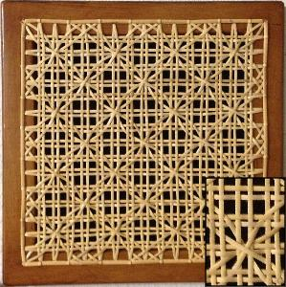
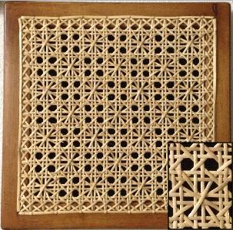
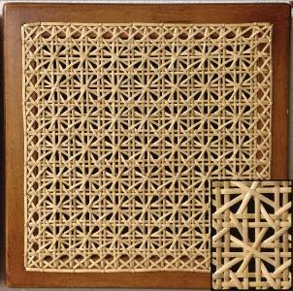
Daisy Chain
Daisy & Button
Double Daisy

Slide 4
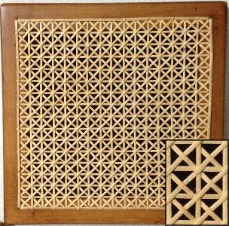
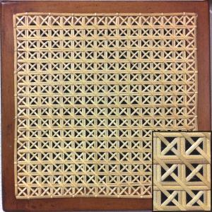
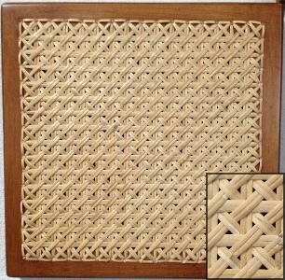
Single Victoria
Double Victoria
Double Double Victoria

Slide 5
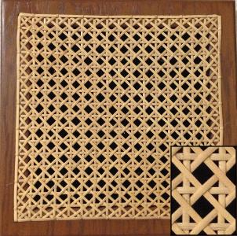
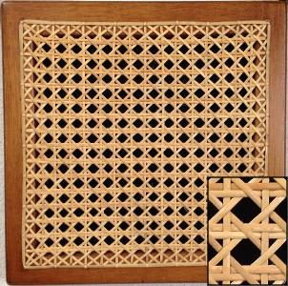
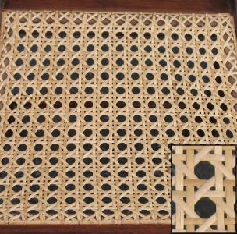
Four Way
Five Way
Standard Six Way

Slide 6
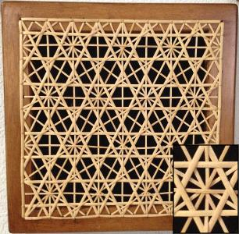
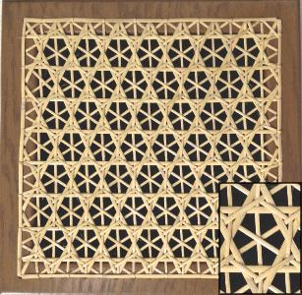
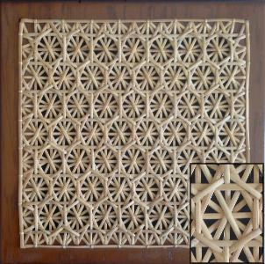
Star of David
Snowflake
Honeycomb

Slide 7
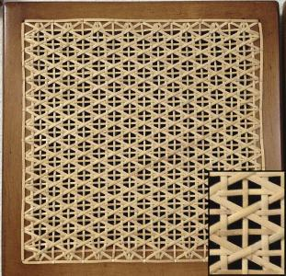
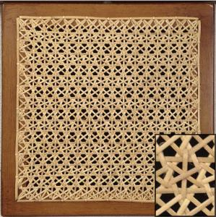
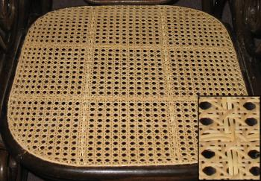
Iron Cross
Lace
Neat reinforcement

