Slide 1
Let’s Get Fancy II
Faith Blackwell

Slide 2
…cut from a chair
This pattern was also found by Sue Muldoon—this one, cut from a chair she had… This one was *much* easier to do! I love this pattern in its simplicity—and can’t wait to put it in something Cane sizes I used:
Narrow Medium / Fine Fine

Slide 3
…cut from a chair
…unfortunately didn’t take as many photos when I did this one. This picture is effectively steps 1-4.
Step 1: Narrow Medium Diagonal #1: lower left to upper right. (Every hole top/bottom; Every other hole left/right)
Step 2: Narrow Medium Diagonal #2: lower right to upper left. ON TOP of Step 1 (Every hole top/bottom; Every other hole left/right)

Slide 4
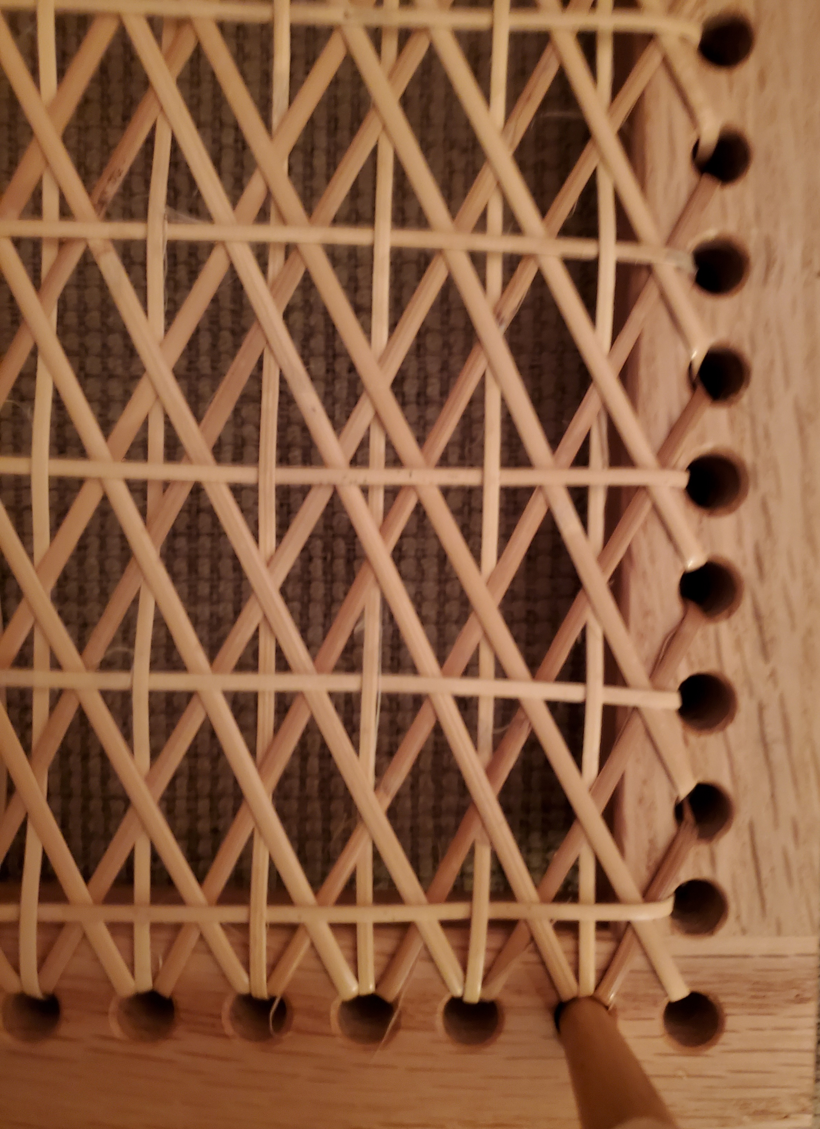
…cut from a chair
Step 3: Fine/Fine First Horizontal. Every other hole on TOP of everything. (This will be the center horizontal)
Step 4: Fine/Fine Vertical. Ignoring *all* the crosses from Steps 1&2, go over and under ONLY the cane from Step 3 (horizontal). Basically you’re going under all the Xs from 1&2

Slide 5
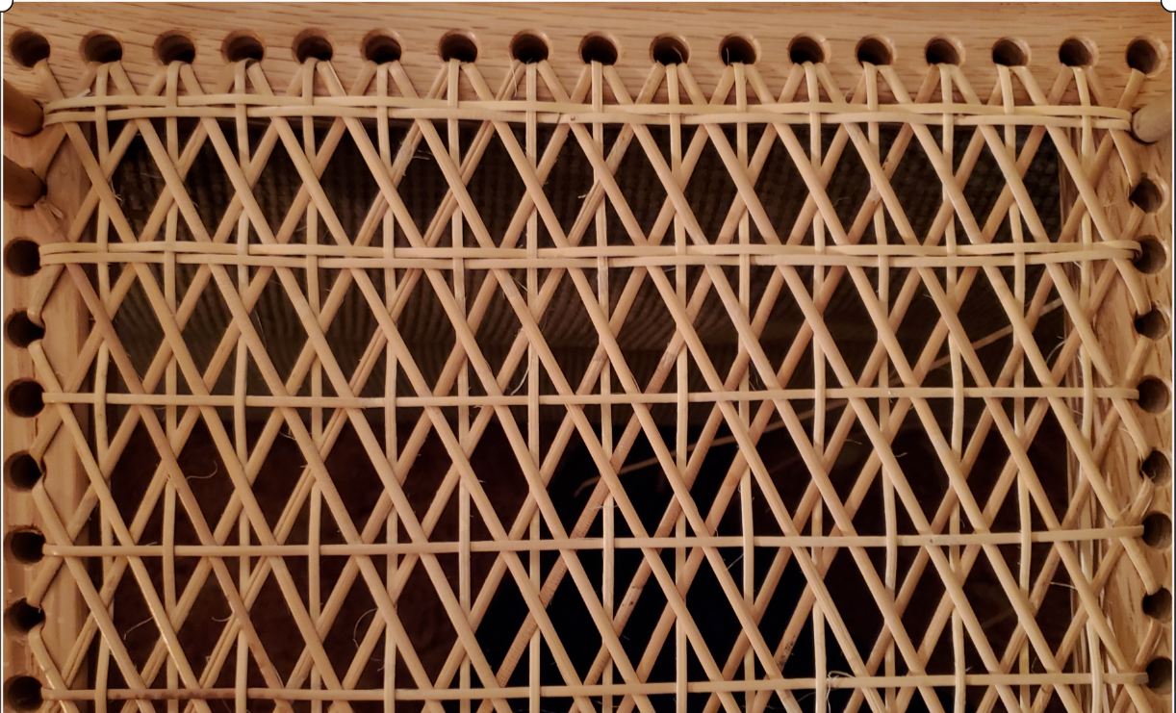
Step 5
Step 5: Fine/Fine Second Horizontal. Above the first horizontal, go over and under the verticals from Step 4, OPPOSITE STEP 3.

Slide 6
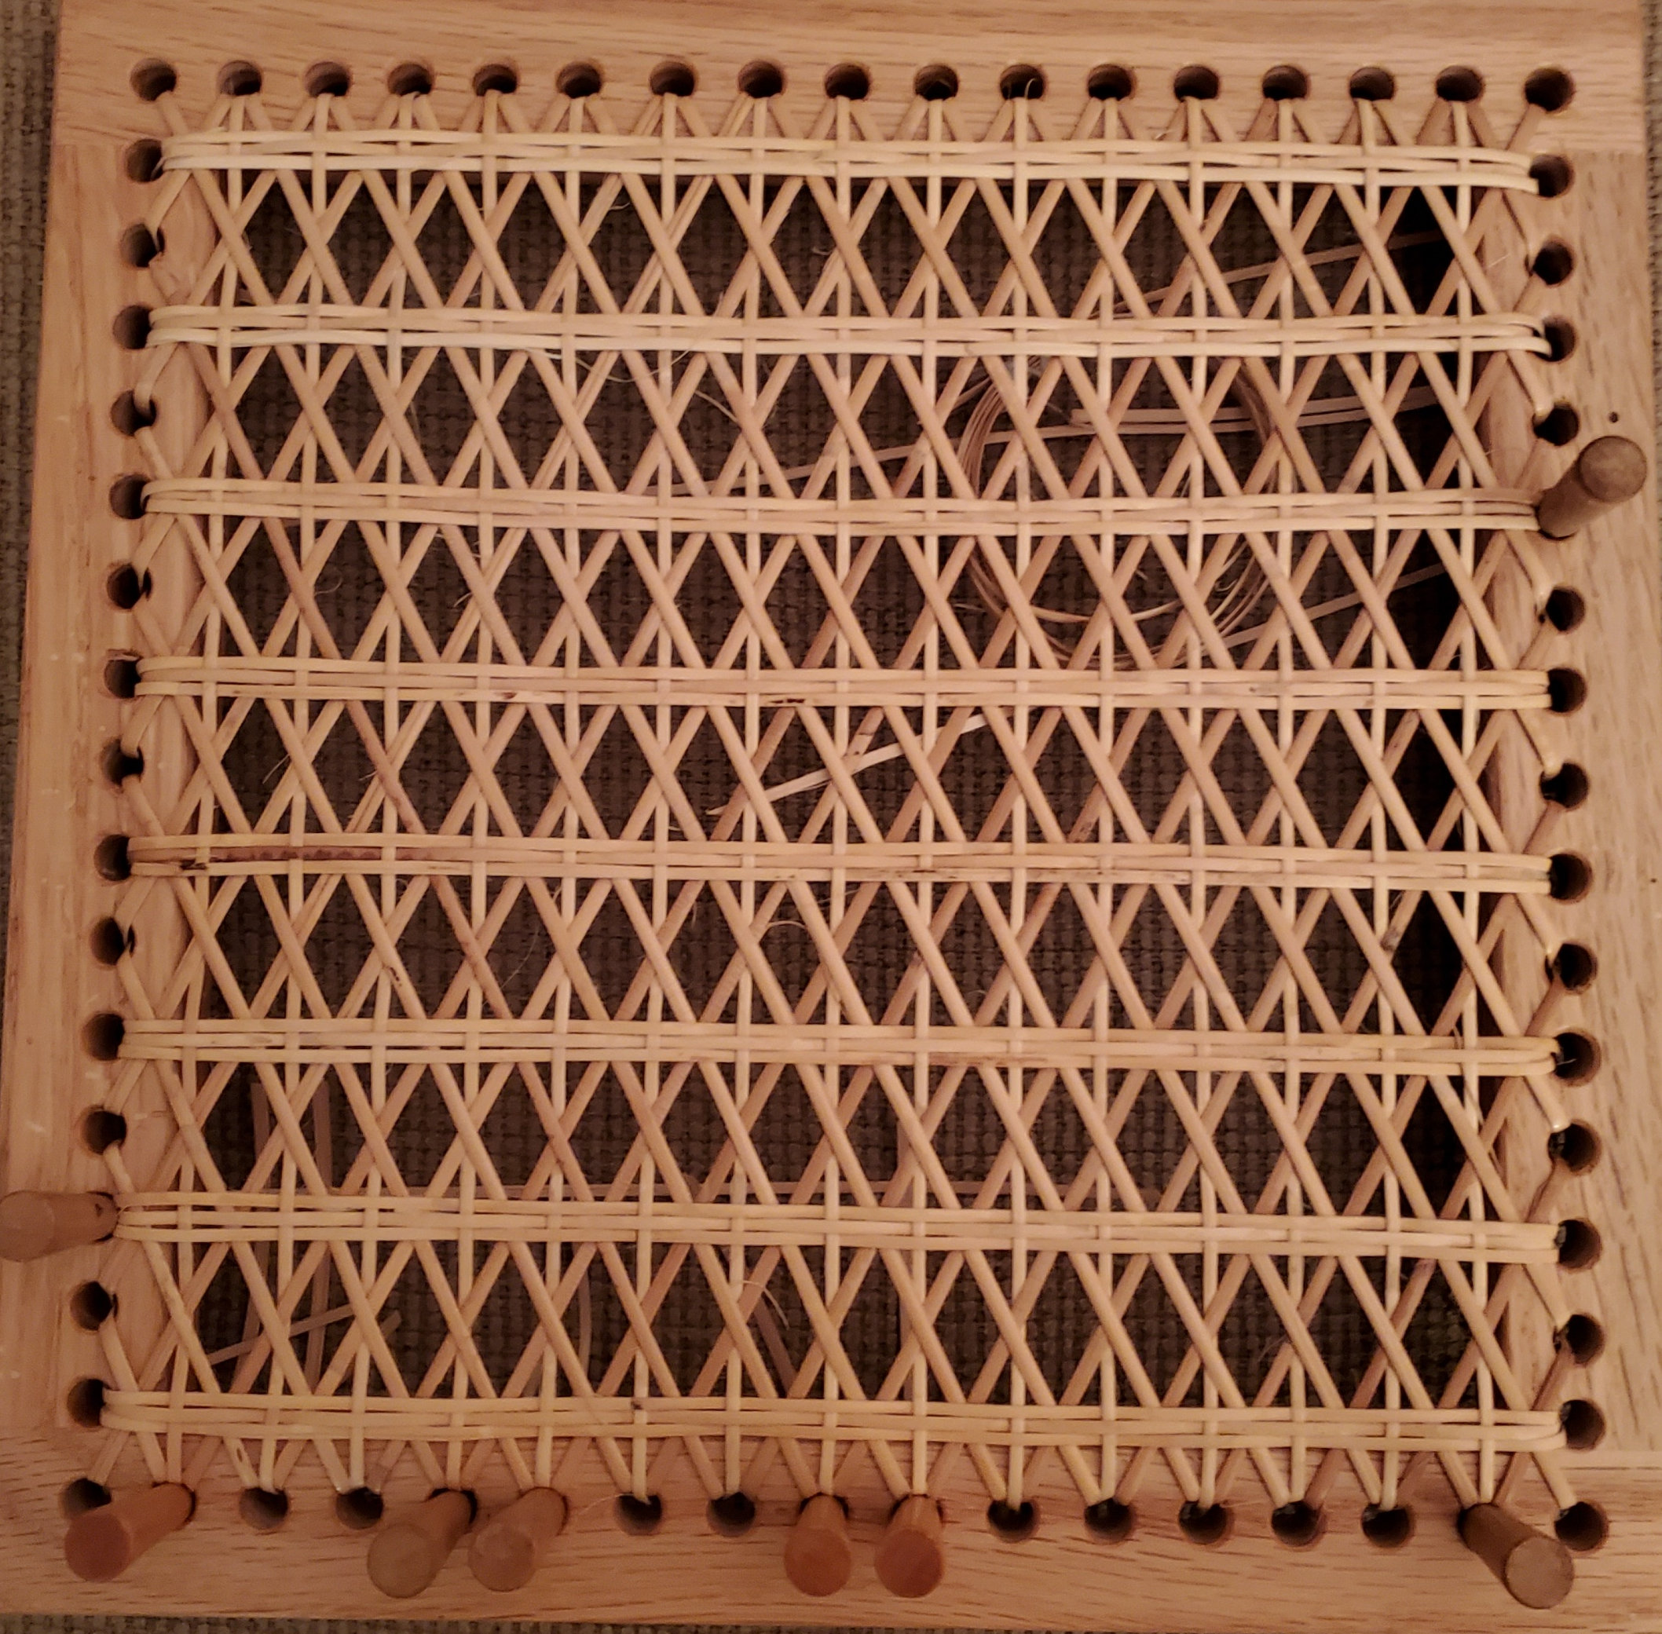
Step 6
Step 6: Fine/Fine Third Horizontal. Below the first horizontal, go over and under the verticals from Step 4, OPPOSITE STEP 3, but same as Step 5

Slide 7
